Slide 1
Understanding and Solving Java Memory Problems
COURSE OVERVIEW
Notes:
Presenter
2017-03-24 15:08:48
--------------------------------------------
Hello and welcome to “Understanding and Solving Memory Problems” authored by Richard Warburton. Normally when we think about the best to write Java code we’re often thinking about the maintainability of the software – for example does it follow OOP best practices, is it well tested, can you add features easily. This course is a bit different, and in many ways more exciting than that. It talks about the kind of problems that can happen to well factored and tested code in production. We’ll be categorising and explaining a series of problems that are related to memory and we’ll demonstrate how you can use freely available tooling and battle-tested approaches to solve these problems.

Slide 2
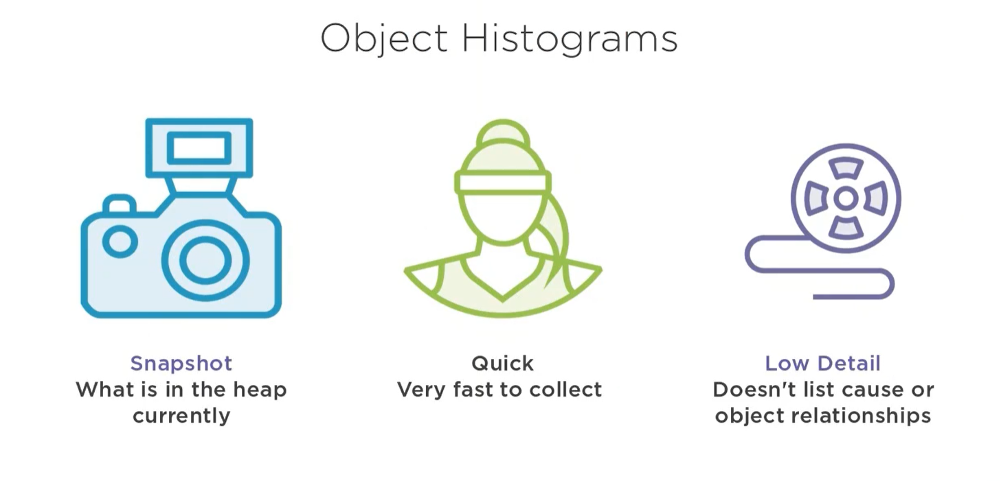
Notes:
Presenter
2017-03-24 15:08:49
--------------------------------------------
But before we get onto the problems themselves I think we need to explain why you should care about memory problems at all in your Java application.

Slide 3
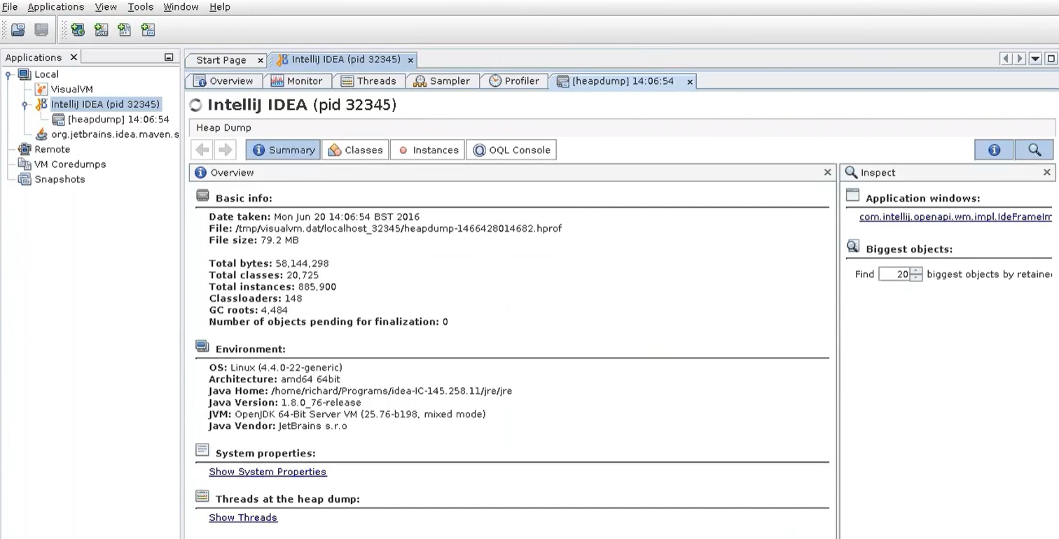
Notes:
Presenter
2017-03-24 15:08:49
--------------------------------------------
The first thing that people think about when it comes to Java Memory Problems is that Java has a Garbage Collector or GC. It was one of the first mainstream, popular, programming languages to use GC, although far from the first. It’s proven to be an incredibly popular feature and huge amount of engineering work has been undertaken by GC writers to make them really, really fast. But the thing to remember with GCs are that they are just computer programs themselves, not some kind of magic black box that solves all your problems. They will free up memory when it isn’t in use by an application but that is the end of their remit.
If you write code that blindly leaks memory, or uses too much memory then you can still have problems despite the existence of a GC. This doesn’t mean that the GC is broken – its just that GCs blindly follow your references around in memory. The code and the objects themselves are still King.

Slide 4
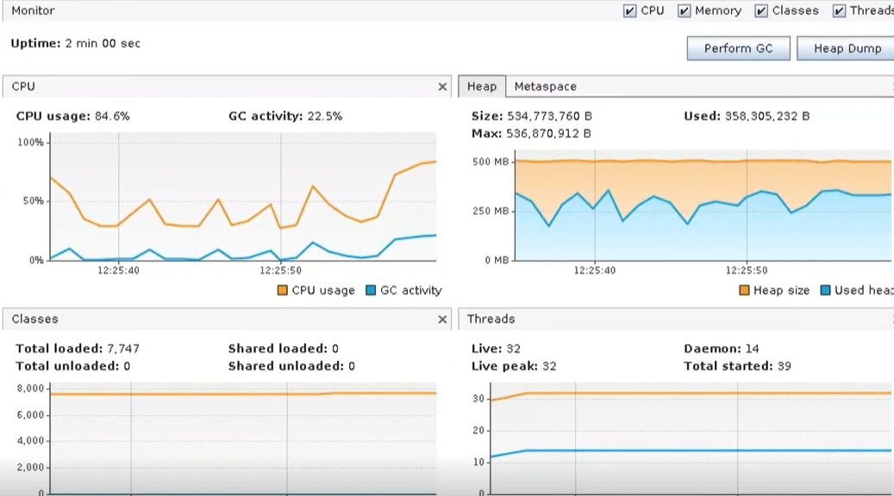

Slide 5
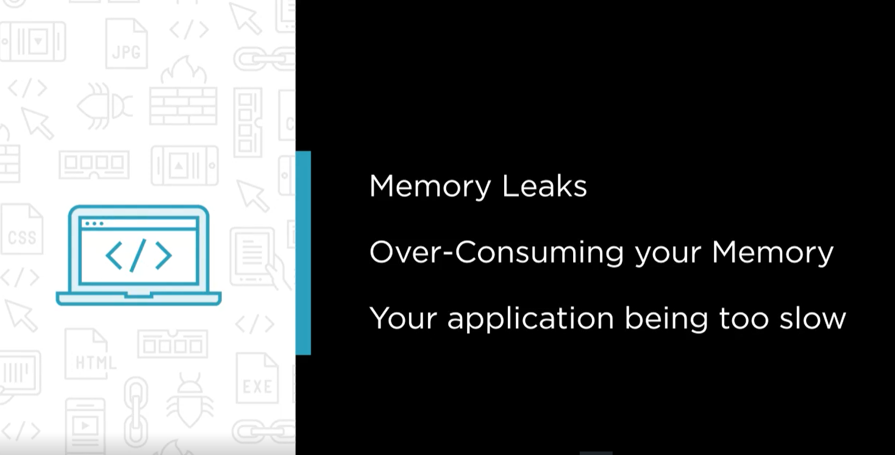

Slide 6


